Slide 1
Analysis of Twitter Dataset for Identification of Influencers of Fake News Within Nodes by
Ezra Shiloba Gbaje
Department of Library and Information Science
Faculty of Education
Federal University Lokoja, Kogi State

Slide 2
Introduction
Currently, more and more people depend on social media for news instead of traditional news media.
Social media has become central to the way people create, and disseminate news
It has, as challenged traditional beliefs of how news should look.

Slide 3
Introduction
Unlike the traditional news media, there is no regulatory authority checking the quality and authenticity of information created and disseminated on social media

Slide 4
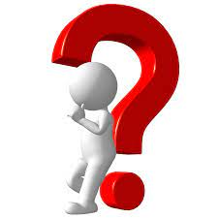
Social media has become a powerful tool for the creation and dissemination of fake news at a tremendous speed to a large audience with very little or no cost to the creator or disseminator.

Slide 5
Concept and definition of fake news
Scholars have argued that fake news is distinct from other terms even though they are closely related in meaning and sometimes overlapping.

Slide 6
Consequence of Fake News
Fake news is a serious threat in the society, they can result to loss of lives and properties, confusion in the society
It is also a threat to democracy, public health as well as question the credibility of governments and public institutions.

Slide 7
Closely Related Concepts
Fake news
Fabricated news
Parody/satire news
Propaganda
Disinformation
Clickbait news
Misinformation

Slide 8
The boundary between each of these terms is ambiguous, and sometimes used interchangeably in some cases.
The lack of agreement of what constitutes fake news has also resulted in the non-acceptance of a single universal definition of fake news

Slide 9
Definition of Fake News
Conroy et.al (2015), described fake news to be news articles that are purposely and verifiably false, with the sole aim and purpose to possibly mislead readers.
Allcott and Gentzkow (2017), defines fake news to be news articles that are intentionally and verifiably false, and could mislead readers.

Slide 10
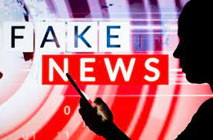
Common denominators in the definitions of fake news is that it is:
verifiably false,
misleading,
disinformation and
manipulative

Slide 11
Fake news is a subject of research, with some scholars focusing their efforts on:
the source of fake news,
fake news consumption,
fake news detection,
dissemination of fake news
impact of fake news, and
motivation for spreading fake news etc

Slide 12
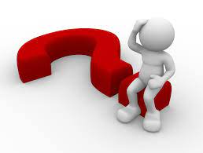
The Problem
The researchers noted with concern that fake news is emanating, disseminating and thrive amongst ethnic cultural and religious ties in Nigeria.
Thereby threatening the peace, unity, security and corporate existences of Nigerians

Slide 13
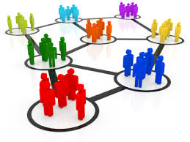
In this study social network analysis was used to analyze the structure of the network to identify the major actors, how they create and disseminate fake news as well as identify the sentiment towards tweets being disseminated in the network.

Slide 14
The major actors in a social network have become powerful sources, in creating and disseminating fake news because they shape social network attitude, belief and behavior.

Slide 15
Hence the study harvested tweets on one major ethnic issues Arewa.
The tweets harvested were analysed using Network and sentiment analysis.

Slide 16
Who are the major actors/ influencer in the dissemination of fake news within the ethnic groups analyzed ?

Slide 17
Twitter microblogging
Disseminating information in real time.
It allows for only shot messages and makes it publicly available.
Contents are mainly user-generated, and lack fact-checking mechanisms
Majority of twitter data is open for all analyze.
used in analyzing feelings, relationships, interactions and opinions and measuring people’s satisfaction with services offered.

Slide 18
Methodology
This study uses a mixed methods research paradigm driven by pragmatism: More specifically, it uses a sequential mixed methods design with a quantitative method followed by qualitative methods.
The purpose of the qualitative methods is to explain the quantitative results.

Slide 19
Mozdeh software
The quantitative data were collected using Mozdeh Big Data Analysis software.
Mozdeh software was used to collects tweets through Twitter’s Streaming API to build a corpus of tweets, collected tweets from January 1, 2016 to June 39, 2021.

Slide 20
Data Collected
A total of 19,264 tweets and over 104.7 million retweets were collected.
Data collected include the :
text of the tweet
username of the person who posted the tweet
username of the person who retweet
original tweet
or a retweet.

Slide 21
From the corpus of tweets collected the number of tweets on each keyword/phrase as well as the number of retweets greater than 100 are indicated in table below:
Keywords | No of Tweets | No. of Retweets >100 | Fake News Identified in Retweets >100
Arewa clash | 309 | - | -
Arewa resource control | 25 | - | -
Arewa Marginalization | 77 | - | -
Arewa militants | 299 | 3 | 1
Arewa Fulani | 3658 | 96 | 7
Arewa Ethnic Cleaning | 42 | - | 1
Arewa religious crisis | 24 | - | -
Zangon-Kataf | 393 | 11 | -
Zangon-Kataf herdsmen | 10 | - | -
Zangon-Kataf grazing land | 285 | - | -
Zangon-Kataf Fulani | 53 | 3 | -
Zangon-Kataf genocide | 3 | - | -
Zangon-Kataf crisis | 28 | 1 | -
Zangon-Kataf killings | 10 | - | -
Kajuru killing | 3191 | 81 | -
Kajuru grazing land | 32 | - | -
Kajuru herdsmen | 514 | 24 | -
Kajuru fulani | 1247 | 43 | -
Kajuru cleansing | 36 | - | --
Kajuru religious crisis | 76 | 1 | -

Slide 22
To identify the influences in the public discourse on the keywords used for this study we selected only the major actors who had over four thousand retweets
S/No | Tweeter handle | Followers | Tweets | Retweets
1 | Amaka_Ekwo | 137,827 | 117 | 33,059
2 | NkemdiMary | 28,956 | 124 | 30,726
3 | MaziNnamdiKanu | 336,076 | 4 | 13,464
4 | xtobaba9 | 1,052 | 4 | 11,486
5 | sKefason | 9,363 | 125 | 14,243
6 | Savndaniel | 14,765 | 314 | 7,758
7 | SaharaReporters | 374,5316 | 21 | 5,663
8 | realFFK | 1,029,579 | 5 | 5,047
9 | NkirukaNistoran | 30,243 | 37 | 4,882
10 | AgorasBlog | 56,565 | 20 | 4,276

Slide 23
Table 2 shows the tweeter handle of the top 10 major actors/influencers
Note that even though tweeter handle MaziNnamdiKanu, and xtobaba9 had tweets below 5 they had thousands of retweets
With the number of follower MaziNnamdiKanu is a key influencer in this social network.
Furthermore from the data collected users mBuhari and elrufia had no tweets but were only received tweets from many users and also got mentioned by many users

Slide 24
Figure1: Major Influencers in the Node

Slide 25
Major Influencers in the Node
The network shows the conversational connections made by the users. Therefore, when User mBhari mentions or retweets User elrufia, there is a connection between those two nodes. The graphs are directed, which allows us to identify those that either made or received more mentions. The users mBhari and elrufia who received a lot of retweets and mentions are classified as opinion leaders.

Slide 26
Figure 2: Communication links between 10 Major Actors/Influencers in the Social Networkm

Slide 27
Relationship between the major actors/influencers is depicted in figure 2. The figure revealed that the tweeter handle Amaka_Ekwo communicate with five of the top 10 major actors/influencers, while sKefason has a communication link with only 1 of the top 10 major influencers.

Slide 28
Identifying Fake news
The researcher filtered out tweets that were retweeted more than 100 times using mozdeh big data analysis software.
The result showed that 459 tweets were retweeted more than 100 time
9 tweets were identify as fake news as shown in table 3.

Slide 29
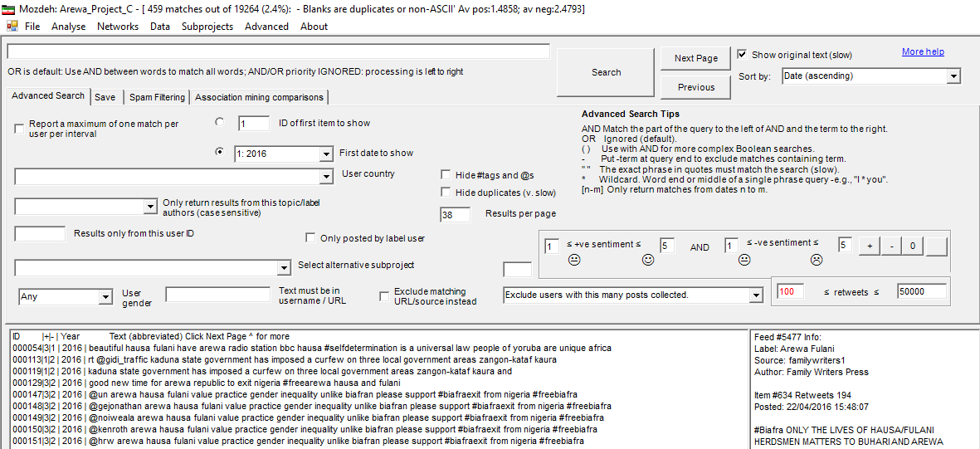
Figure 3: Tweets Retweeted more than 100 times

Slide 30
Source | Tweet | Date and Time Posted | No of Retweets | Fact Check
Label: Arewa Fulani Source: uzonnamichael Author: uzonnamichael | RT @NGRWailers: Avengers/IPOB is sponsored by GEJ to make Nigeria Ungovernable for Buhari - Arewa So who is sponsoring Fulani Herdsmen | 14/06/2016 23:14:28 | 172 | Nigeria: Goodluck Jonathan Rejects Niger Delta Avengers Claim BY CONOR GAFFEY ON 8/9/16 AT 8:22 AM EDT https://www.newsweek.com/nigeria-goodluck-jonathan-rejects-niger-delta-avengers-claim-488722
Label: Arewa Fulani Source: MaziNnamdiKanu Author: Mazi Nnamdi Kanu | Peter Obi's convoy viciously attacked yesterday in Abuja by Arewa street urchins. Imagine a Fulani politician enduring such in Biafraland. By now Ohaneze and Igbo governors would have asked Aso Rock to bomb Afaraukwu and kill every youth on sight. When will we learn? https://t.co/QeJItwkVhw | 10/02/2019 12:08:42 | 1773 | A tweet from the official handle of Peter Obi shows that attacks did happen but it was after his departure. Also, there is no evidence of the ethnicity of the people who carried out the attacks or the weapons used and the numbers are inconsistent. https://dubawa.org/peter-obis-convoy-was-not-attacked-in-abuja-market/
Label: Arewa Fulani Source: MFaarees_ Author: F A A R E E S 💫 🇵🇸 | Arewa people, this where our voices should be heard, not some violent #EndSARS stuff, they're killing our people in Ibadan, Oyo State, they're destroying cars, killing anything Arewa, Hausa or Fulani, it's time to talk, let's all call upon the government to stop them. #IAmNorth💔 https://t.co/jkAiH8rjuX | 13/02/2021 14:15:52 | 268 | Fact: Several people have lost their lives after a clash triggered by the fatal stabbing of a cobbler by a cart pusher in Sasha market, Ibadan, Oyo State, degenerated into an ethnic conflict. Buhari had no part in the conflict https://www.premiumtimesng.com/news/headlines/442757-inside-story-how-artisans-fight-led-to-ethnic-violence-in-oyo.html

Slide 31
Source | Tweet | Date and Time Posted | No of Retweets | Fact Check
Label: Arewa Fulani Source: babujii219 Author: North_depender | RT @AM_Saleeem: They're killing innocent Hausa people in Oyo State all because of Buhari. It's high time Arewa Twitter come together and vo… | 17/02/2021 08:24:40 | 372 | Fact: Several people have lost their lives after a clash triggered by the fatal stabbing of a cobbler by a cart pusher in Sasha market, Ibadan, Oyo State, degenerated into an ethnic conflict. Buhari had no part in the conflict https://www.premiumtimesng.com/news/headlines/442757-inside-story-how-artisans-fight-led-to-ethnic-violence-in-oyo.html
Label: Arewa ethnic cleansing Source: AgorasBlog Author: ≋ A B ≋ | 1,000s of people have been murdered by Buhari’s gov’t (extrajudicial killings, El-Rufai, Arewa’s Boko Haram & bloodthirsty Fulani herdsmen). https://t.co/tTl7teWDNJ | 30/01/2017 14:55:10 | 288
Label: Arewa militants Source: NkemdiMary Author: Mary Mkemdi | Arewa North dominated by Fulani have been secretly sending Coronavirus patients in name of sending out their alamajiri group to Enugu state since the lockdown started. Some of those almajiri sent to Enugu State but intercepted by security agents were tested & found postive – IPOB | 05/05/2020 11:06:06 | 101 | The Enugu State government yesterday intercepted and turned back nine busloads of almajirai following a failed attempt to sneak them into the state. No evidence of covid 19 test carried out on the almajiri to confirm f the were coronavirus patients - https://guardian.ng/news/south-east-south-south-clamp-down-on-almajirai-relocating-from-north/

Slide 32
Sentiment Analysis of Tweets
Sentiment analysis for this study examines the average sentiment of multiple sets of tweets that were retweeted more than 100 times.
The results revealed that there were more negative opinions expressed in the tweets and retweets collected

Slide 33
Major influencers Sentiment Analysis in the Node
S/No | Tweeter handle | Followers | Tweets | Av. Pos | Av. Neg | Av. Pos – Av. Neg
1 | Amaka_Ekwo | 137,827 | 117 | 2.34 | 2.01 | 0.33
2 | NkemdiMary | 28,956 | 124 | 1.82 | 2.45 | -0.63
3 | MaziNnamdiKanu | 336,076 | 4 | 2.5 | 3.25 | -0.75
4 | xtobaba9 | 1,052 | 4 | 1.00 | 4.0 | -3.00
5 | sKefason | 9,363 | 125 | 1.23 | 2.11 | -0.88
6 | Savndaniel | 14,765 | 314 | 1.08 | 3.71 | -2.63
7 | SaharaReporters | 374,5316 | 21 | 1.15 | 3.08 | -1.93
8 | realFFK | 1,029,579 | 5 | 1.33 | 3.33 | -2.00
9 | NkirukaNistoran | 30,243 | 37 | 1.21 | 3.21 | -2.00
10 | AgorasBlog | 56,565 | 20 | 1.18 | 2.53 | -1.35

Slide 34
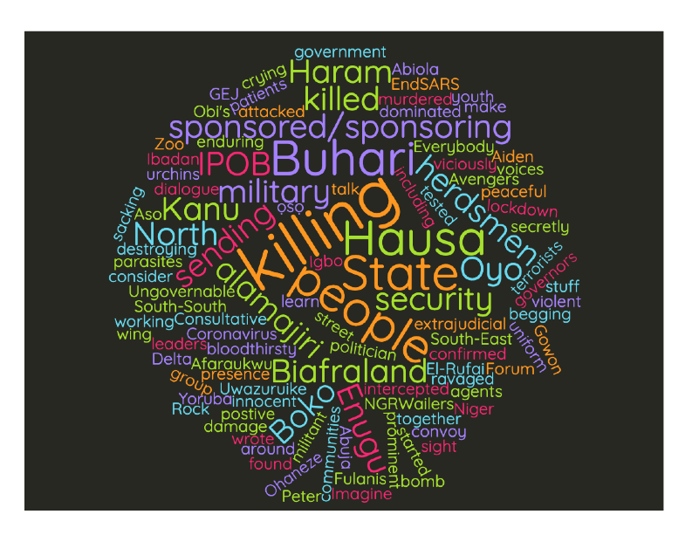
Word Cloud Analysis of Fake news

Slide 35
Summary of Findings
Three major influencers are responsible for the creation and dissemination of fake news amongst others in the node.
Fake news created and disseminated using twitter and containing the selected key words is minimal, hence does not play much role in the crisis in the northern part of Nigeria.

Slide 36
Summary of Findings
The use of offensive, aggressive, exaggerating, and threatening words dominate the tweets in the node.

Slide 37
Recommendation
Government and other relevant stakeholders should identify and monitor the tweets of major influencers in a node to debunk fake news and be more proactive to establish the facts.
put in place a system of accountability for fake news that has defamed or caused conflict in the society.

Slide 38
Thank you

